Slide 1

FAKE NEWS DETECTION
USING
NATURAL LANGUAGE PROCESSING​
Mentored by: Dr. Pratik Chakraborty
Submitted by: Saurabh Sanyam Jaiswal (CSE/490/19063)

Slide 2
Table of contents
01
02
03
04
05
06
Introduction
Data Analysis
Data Classification​
Model Analysis and their Alternative Approach​
Comparison Among Models​
Result Analysis​

Slide 3
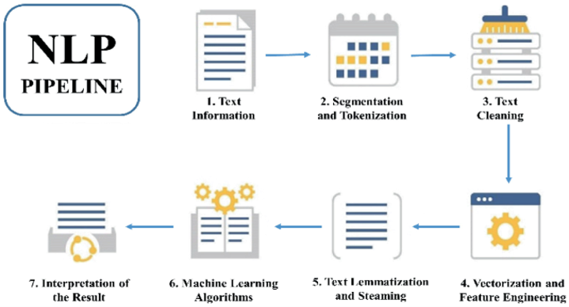
Fake News Detection using NLP

Slide 4
Introduction
In the era of rapid information dissemination through digital platforms, the proliferation of misinformation poses a significant threat to public discourse and decision-making.​
Natural Language Processing (NLP) emerges as a crucial ally in the battle against misinformation, employing advanced linguistic analysis to decipher and evaluate the veracity of textual content.​
The primary goal of this project is to explore and implement NLP techniques for mitigating misinformation, with a specific focus on fake news detection. This involves leveraging computational linguistics to distinguish between credible and deceptive information.​

Slide 5
Dataset Acquisition, Preparation and Exploratory Data Analysis:​
Further EDA, Data Distribution Analysis, Word Clouds:
This chapter involves the initial steps of obtaining the dataset, preparing it for analysis, and conducting exploratory data analysis (EDA). Exploratory analysis helps you understand the basic characteristics and distribution of the data.​
This chapter extends the exploratory data analysis, focusing on additional aspects of the dataset such as the distribution of data across different classes. It also includes the creation and analysis of word clouds to visualize word frequencies in real and fake news articles.​

Slide 6
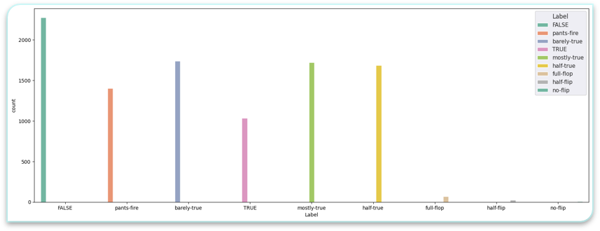
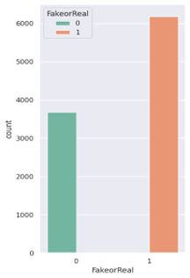
News Legitimacy Distribution​
Binary distribution in the dataset
False: False, Pants-fire​
True: True, Mostly-true, half-true, barely-true

Slide 7
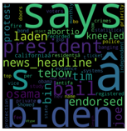


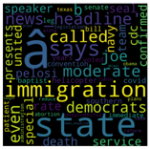
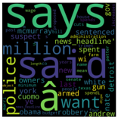

Data Analysis​
Word Cloud Representation of True and False Dataset​:
False
True

Slide 8
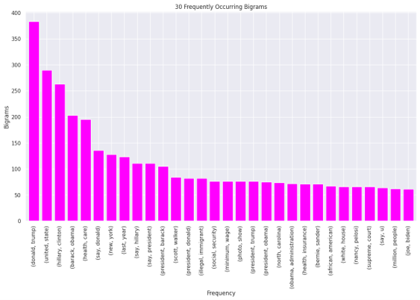
Collation of the SimpleNLP pipeline:​
This chapter involves the execution of the SimpleNLP pipeline, which includes tasks like converting multi-class labeling to binary-class labeling, lemmatization, stop word removals and n-gram analysis. These steps are part of the data preprocessing and analysis process.​

Slide 9
Data Classification​
Text Classification Setup using Fake-Real Dataset:​
Baseline Performance Model - SimpleNLP + TF-IDF Approach + Multinomial Naive Bayes Classifier:​
This chapter sets up the framework for text classification using the acquired dataset.​
Machine learning techniques, classifiers, and evaluation metrics are employed to establish a baseline for performance.
This chapter focuses on building a baseline model for text classification.​
The SimpleNLP pipeline is combined with the TF-IDF approach, and the Multinomial Naive Bayes Classifier is implemented for text classification.​

Slide 10
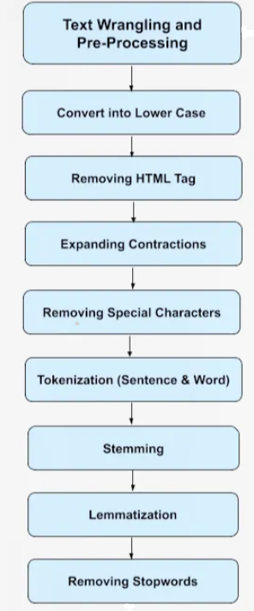
Extensive Data Cleaning NLP Pipeline

Slide 11
Alternative Classification Performance Model - SimpleNLP + TF-IDF Approach + Passive Aggressive Classifier:​
Extensive Data Cleanse NLP (EDC-NLP) Pipeline:​
This chapter explores an alternative approach to text classification.​
The SimpleNLP pipeline with the TF-IDF approach is used, employing the Passive Aggressive Classifier for text classification.
This chapter introduces a more sophisticated approach to text classification.​
The Extensive Data Cleanse NLP (EDC-NLP) pipeline is applied, involving additional data cleansing and processing steps, and its impact on text classification is analyzed.

Slide 12
Baseline Pro Model - EDC-NLP + TF-IDF Approach + Multinomial Naive Bayes Classifier:
This chapter introduces an enhanced model for text classification.​
The EDC-NLP pipeline with the TF-IDF approach is combined with the Multinomial Naive Bayes Classifier to assess performance gains.
Alternative Pro Model - EDC-NLP + TF-IDF Approach + Passive Aggressive Classifier:​
The EDC-NLP pipeline with the TF-IDF approach is combined with the Passive Aggressive Classifier to compare performance with the baseline.

Slide 13
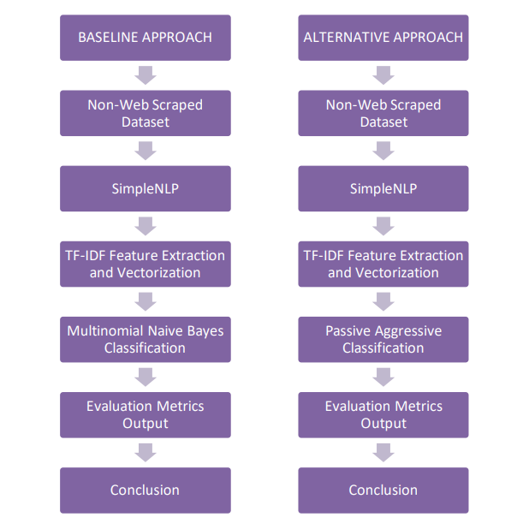
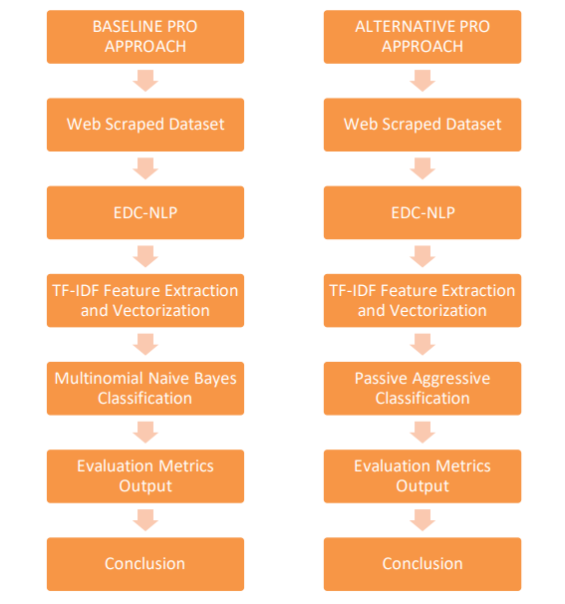

Slide 14
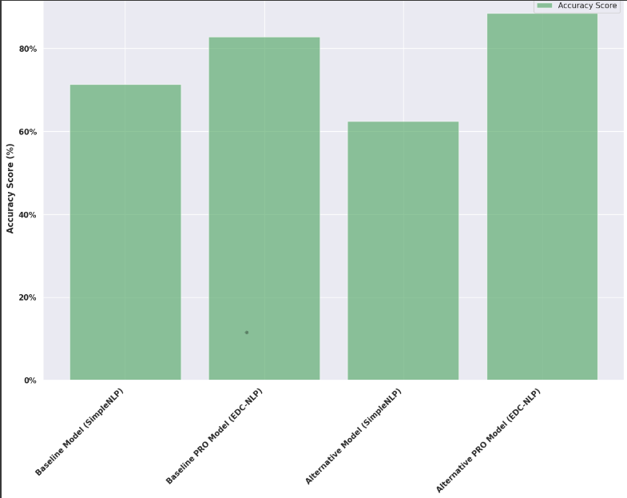
Result Analysis

Slide 15
Conclusion
This project significantly advanced our understanding of misinformation mitigation using NLP techniques. ​
The combination of traditional NLP pipe line , EDC NLP pipeline and machine learning methodologies provided a nuanced approach to fake news detection. ​
As we navigate the evolving landscape of digital information, this project serves as a stepping stone towards building robust systems capable of safeguarding the integrity of information in the digital realm.​

Slide 16
Thank You

